Slide 1
What is Fairtrade?
Learning Objective:
To understand the ideas behind Fairtrade and how it helps communities around the world

Slide 2
What does Fairtrade mean to you?
Fairtrade
Discuss and share with your partner

Slide 3
“Better prices, decent working conditions, local sustainability and fair terms of trade for farmers and workers in developing countries”
The Aims of Fairtrade

Slide 4
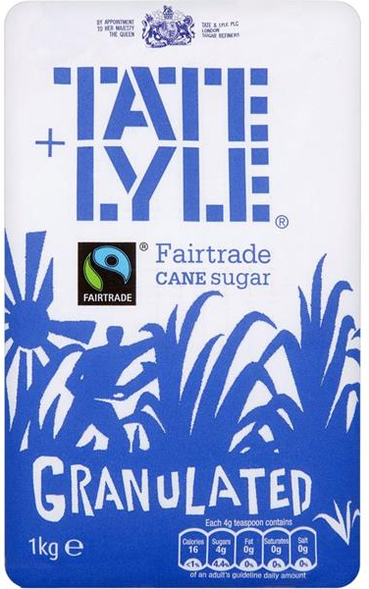
Fairtrade Sugar
“When you choose to buy Tate and Lyle Fairtrade cane sugar, you are making a difference to communities around the world. With your help, through the Fairtrade Premium, we support over 20,000 small scale cane farmers in developing countries”

Slide 5
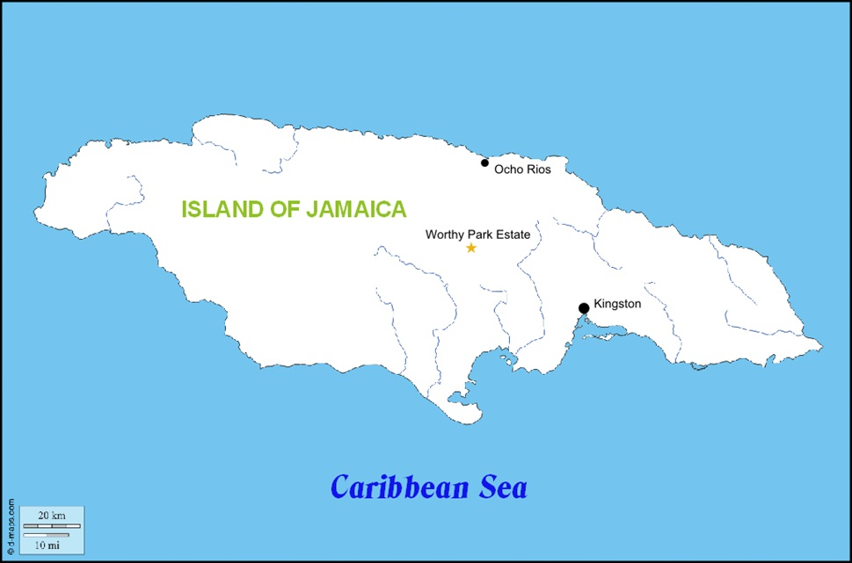
Jamaica

Slide 6
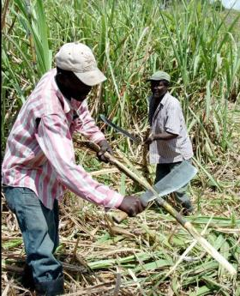
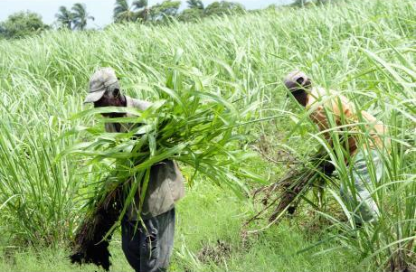
Worthy Park Cane Farmers
The Fairtrade Premium has helped the Worthy Park Cane Farmers

Slide 7
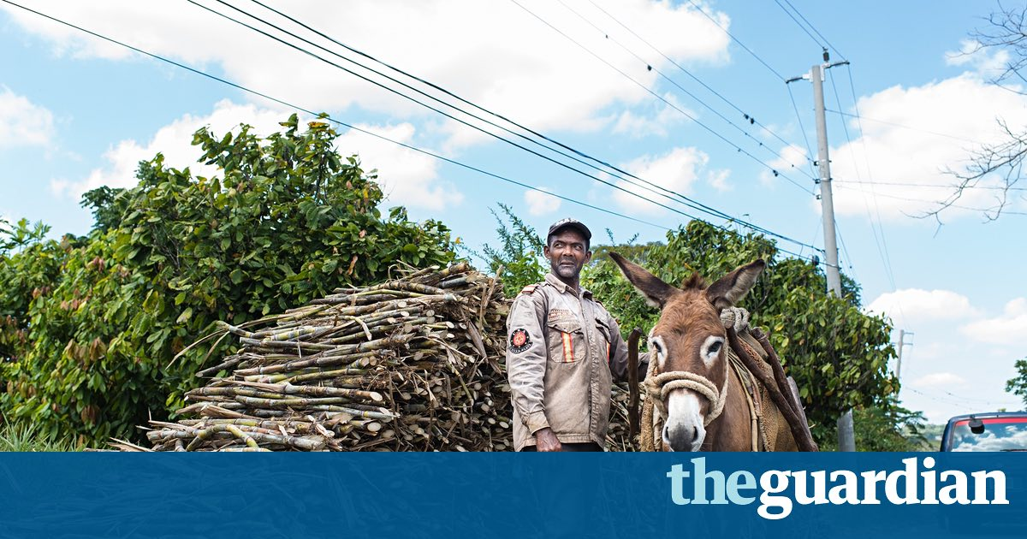
Adolphus’ Story
Photograph by O’Brien Brown and reproduced with permission of
The Fairtrade Foundation.

Slide 8
Activities
Write a report answering the key questions. You could use ICT to communicate your ideas and present your work with additional pictures.
Retell Adolphus’ story using four pictures or through a narrative.
Design a leaflet about the importance of Fairtrade and telling people how the Fairtrade Premium can help producers.
Key Questions
What are the aims of Fairtrade?
How does Tate and Lyle help the cane farmers of Jamaica?
How did the Fairtrade Premium help Adolphus?

